Slide 1
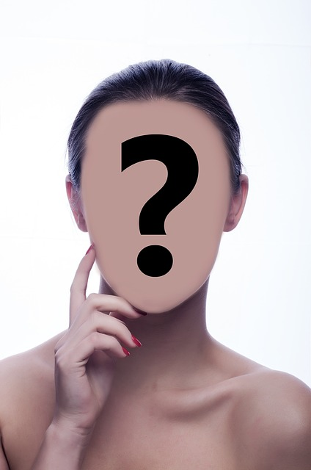
Update Names
Update Dates
Facial Emotion Recognition

Slide 2
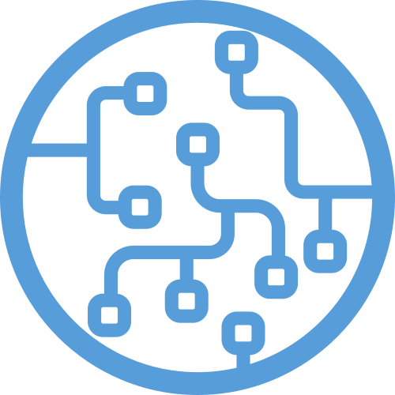
Overview
Intro
Project
Product
Algorithms
Presentation
Conclusion

Slide 3
About Machine Learning
Find algorithms/methods to perform certain tasks independently;
Used for tasks where any rule-based approach is unfeasable.
Data
Intelligence
ML Method
Hypothesis Space
(Model & Parameters)
Loss function
(Optimization Algorithm)
Task
Evaluation

Slide 4
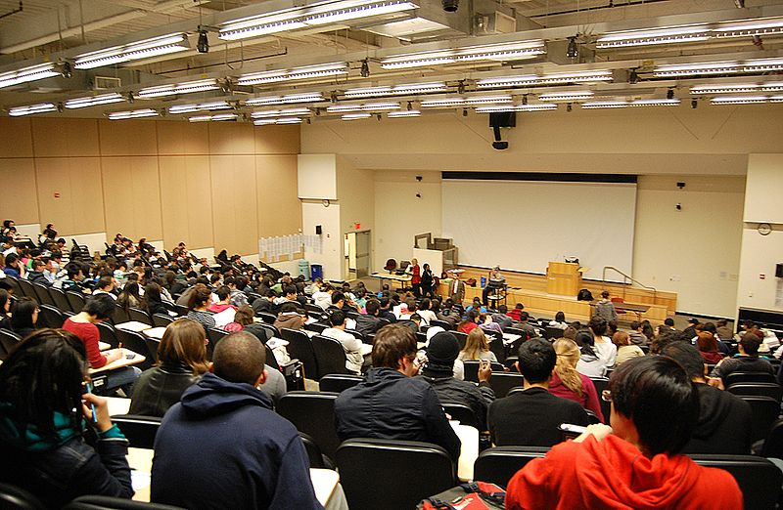

Let’s get concrete
Pandemic
How to see if your students are falling asleep?
Use machine learning for facial emotion recognition, aka our Project!
Notes:
Timo:
Hier können wir die Story bzgl. veränderter Situation erzählen.

Slide 5
Goals
Learn to work together: management and organization + GIT.
Research different ML methods: which suits a given task best?
- Write a document in Latex about the acquired knowledge.
Implement at least one ML algorithm in Python and optimize its accuracy:
- Costumer requirement: classify emotions of faces in an input image.

Slide 6
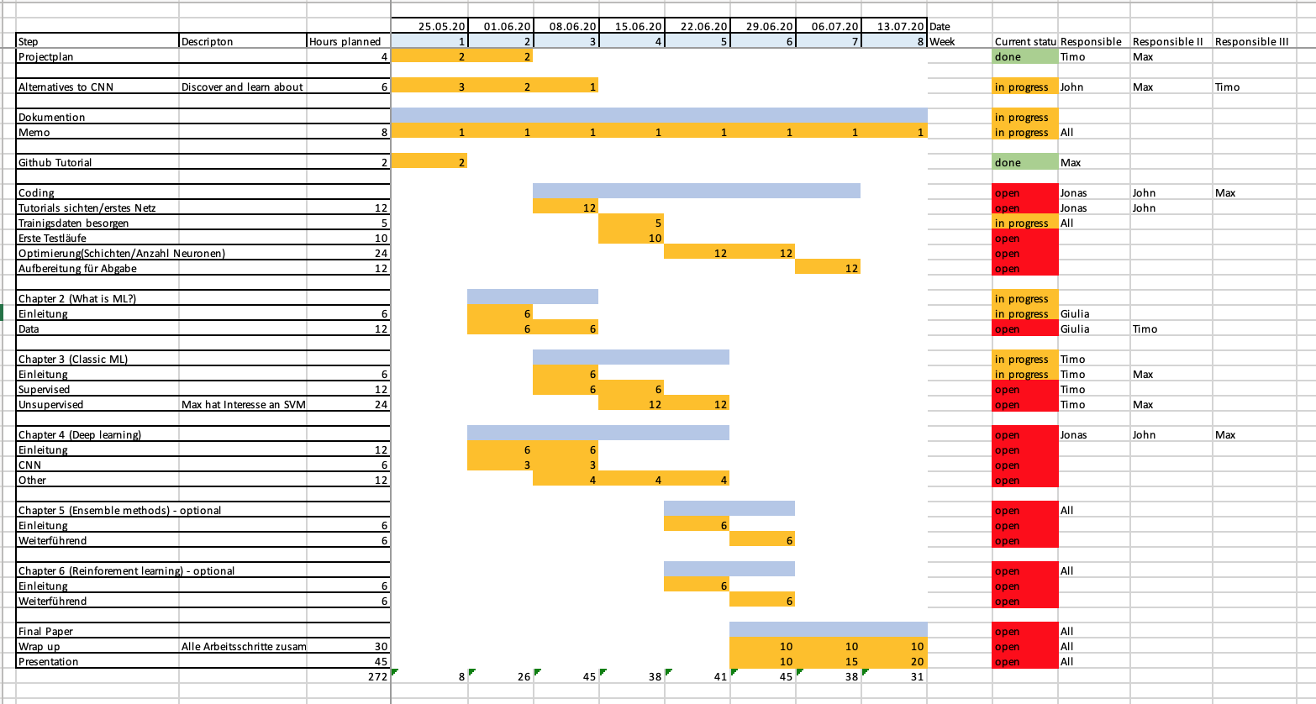
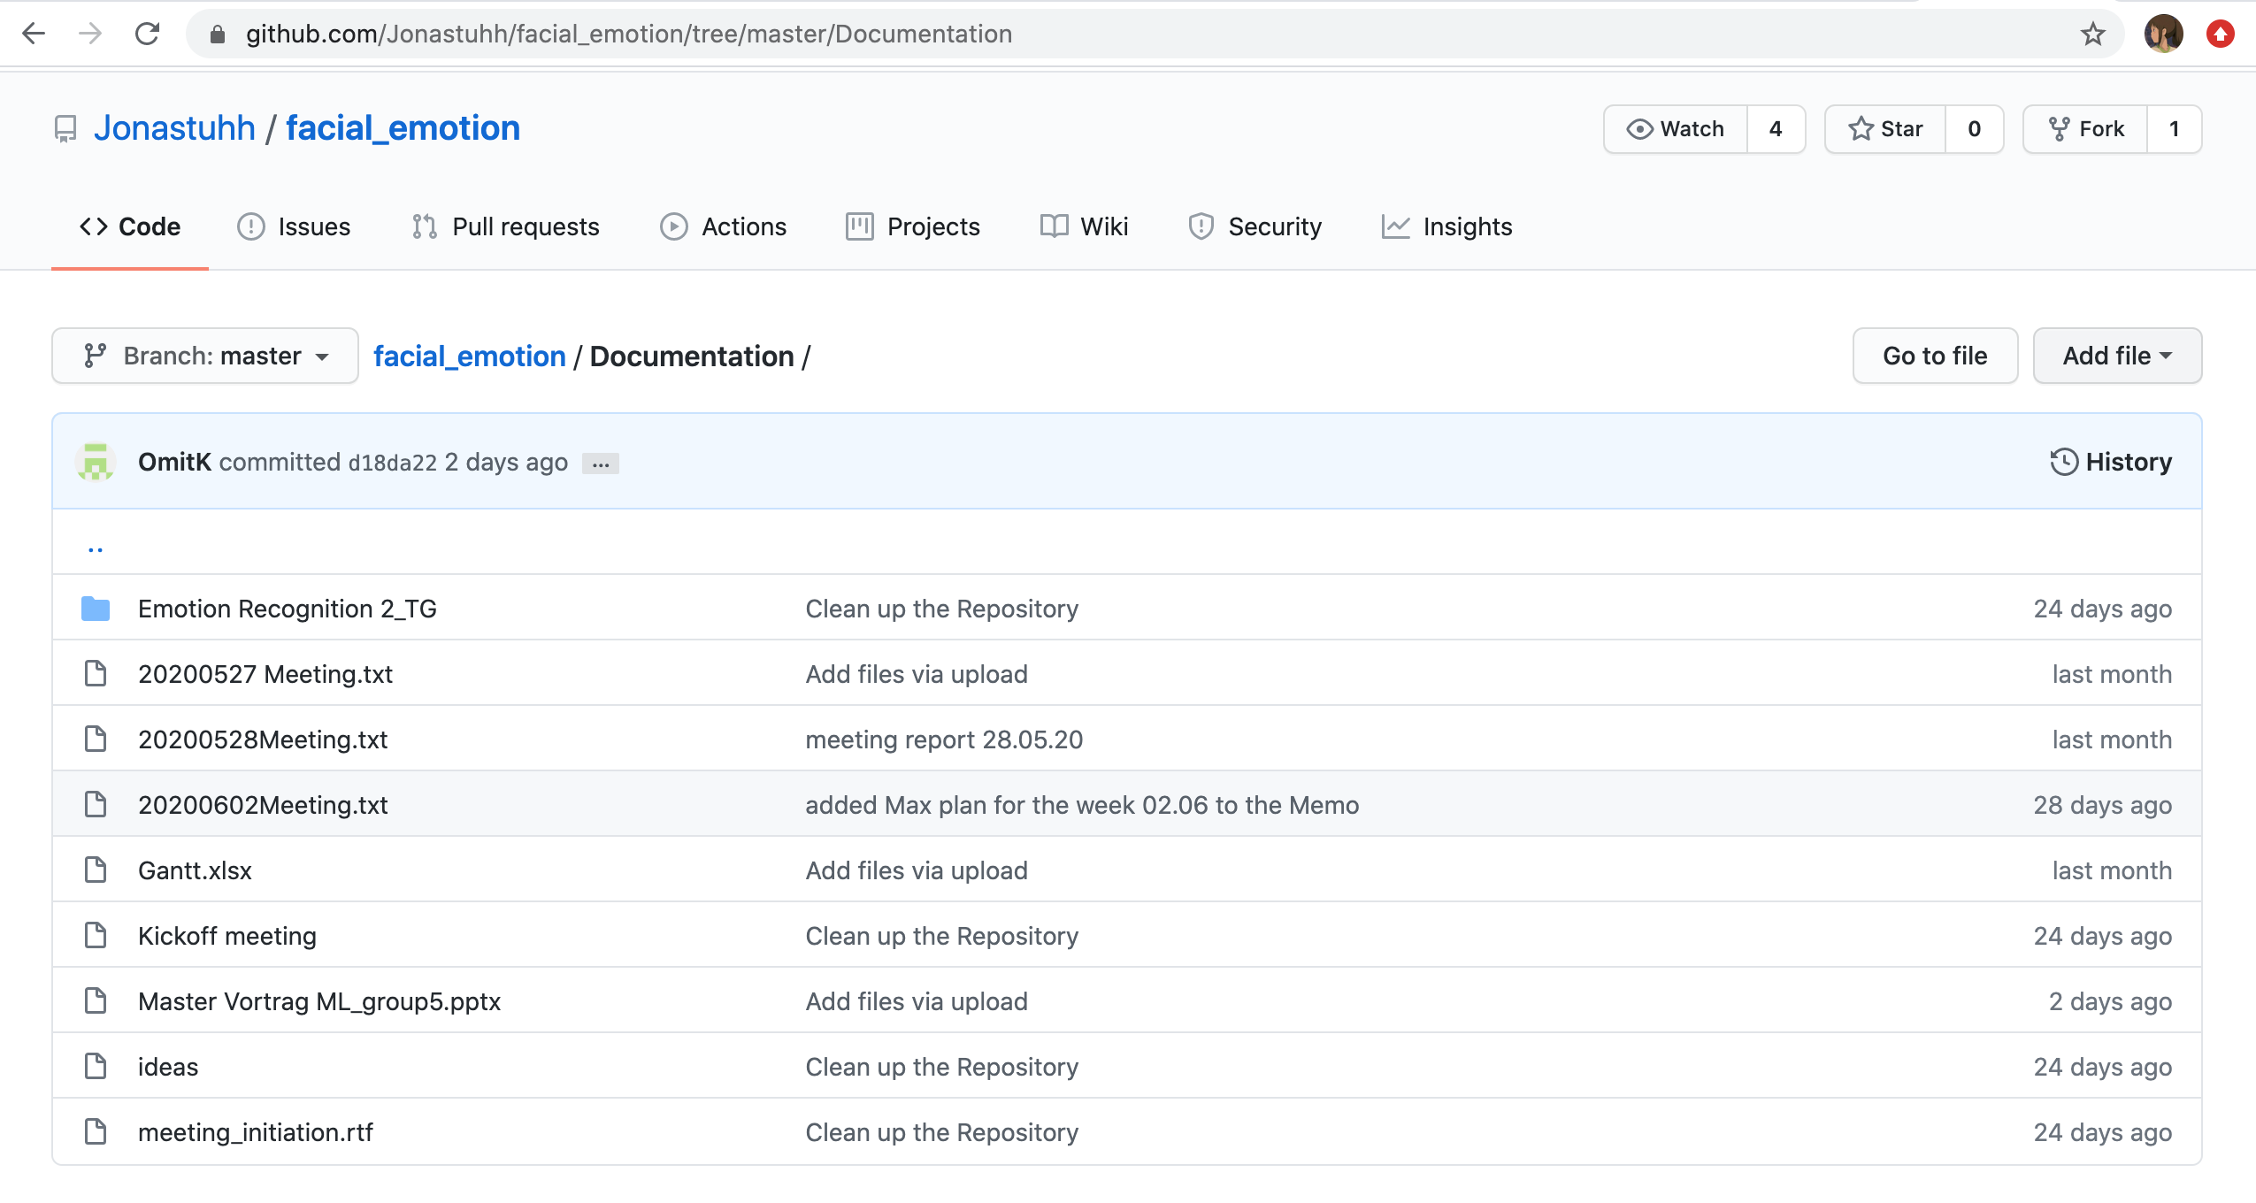
Results
Learn to work together: management and organization + GIT.
- Gantt chart, weekly meetings, communication via Whatsapp.

Slide 7
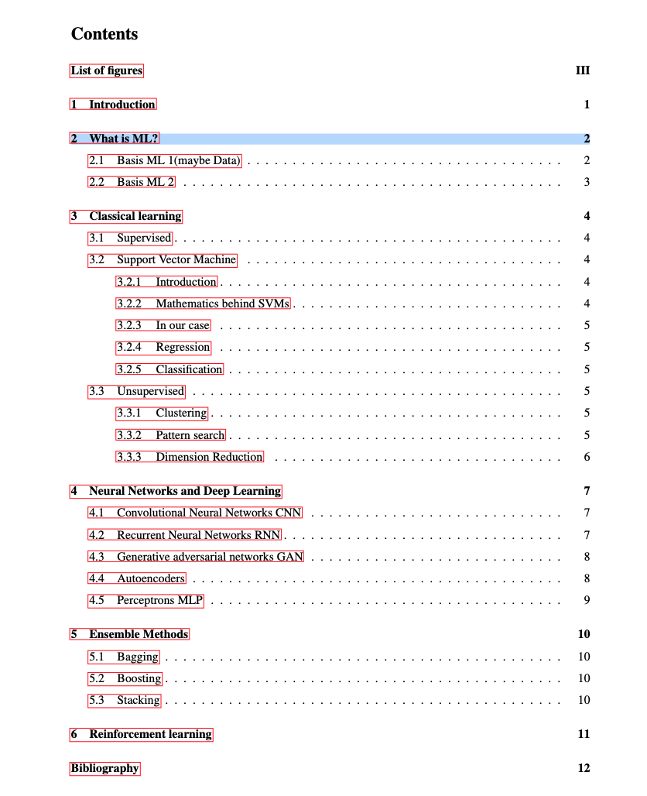
Results
Update
Research different ML methods: which suits a given task best?
- Write a document in Latex about the acquired knowledge.

Slide 8
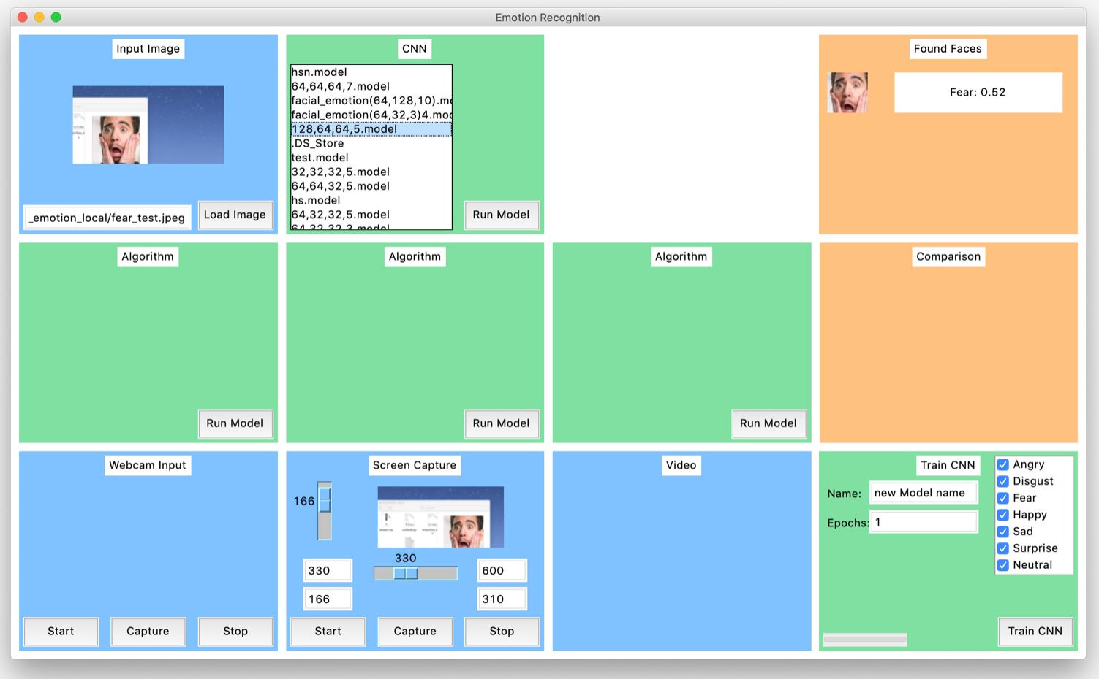
Results
Update
Implement at least one ML algorithm in Python and optimize its accuracy:
- Costumer requirement: classify emotions of faces in an input image.
Responsible | Hyp Space
John | KNN
Jonas | CNN
Max | SVM
Timo | AdaBoost
GUI developed mainly by Jonas.

Slide 9
Algorithms
KNN
AdaBoost
SVM
CNN
Notes:
Here we should give an overview of our algorithms. Also we should mention that we implemented CNN because its normaly the common solution for this problem, but wanted to have some other algorithms to compare with.

Slide 10
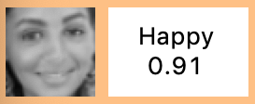
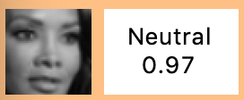
Dataset
Dataset from kaggle competition
48 x 48 Pixel grayscale images
28.709 Training-samples 7.178 Test-samples = 35.887 samples
7 Emotions as labels
Problems with the Dataset
⟺
Labeled as neutral
Labeled as happy

Slide 11
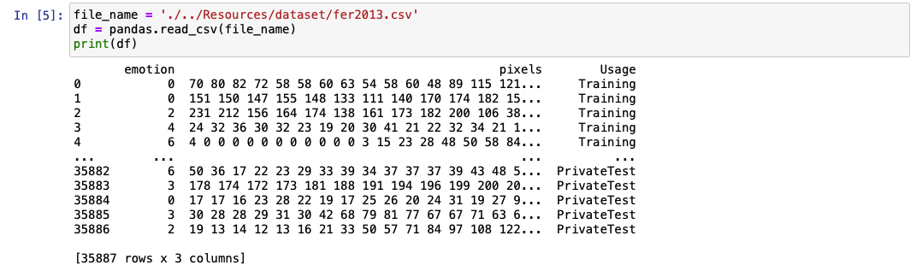

Dataset
Preparing dataset (training / test)
(48 x 48) = 2.304 dimensional input-data
$$⟹x_{n}∈{\{0,…,255\}}^{2.304}$$
Output: $y_{n}∈\left\{0,…,6\right\}$

Slide 12
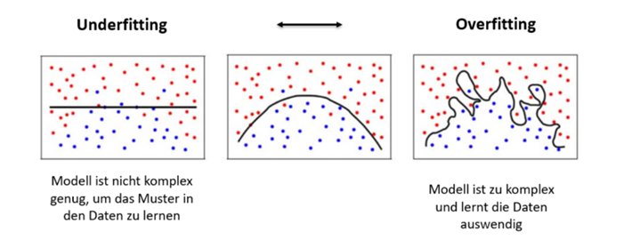
AdaBoost - TBA
Maybe ill add a little bit more here about advant/disadv. Etc
Can be done with different types of weak learner(Trees/KNN/etc)
Can prevent overfitting (as long as iterations are not too large)

Slide 13
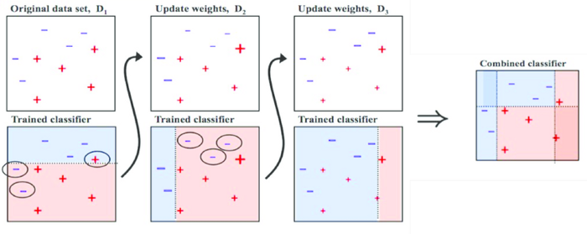
AdaBoost
Notes:
Ensemblemethod (Boosting)
Bagging(Bootstrap)
Random Forest

Slide 14
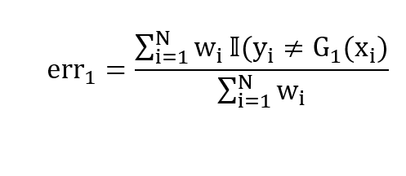
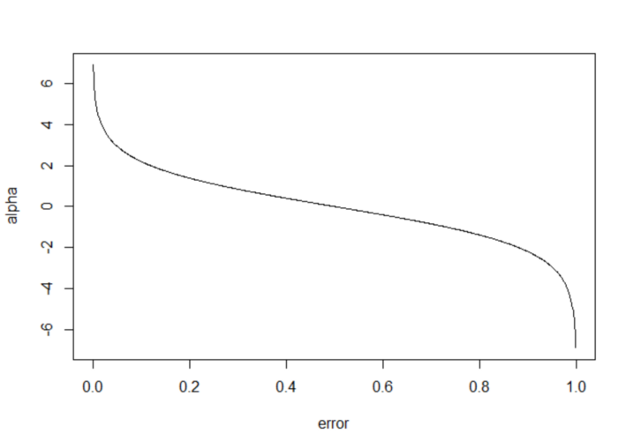
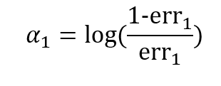
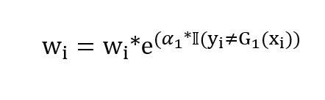
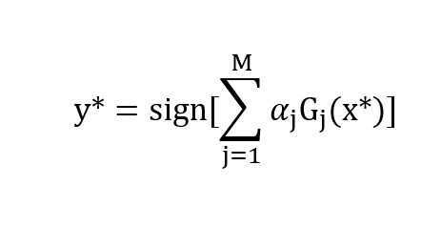
AdaBoost
Calculate error for first Stump G(x):
„Importance of say“ for every Stump:
All samples get a new weight:
We predict a sample with M classifiers:
Notes:
Start with a Stump
Initial weight: w = 1/N
Calculate the error
The higher the error, the less important will be the vote of that tree at the end.

Slide 15
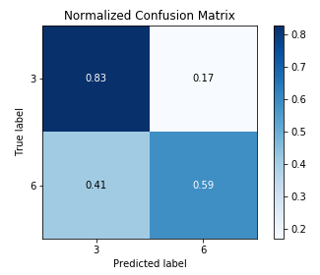
AdaBoost
Accuracy of 36.4% for all 7 classes
Accuracy of 56.7% for Happy / Sad / Neutral
Accuracy of 73.3% for Happy / Neutral
happy
neutral

Slide 16
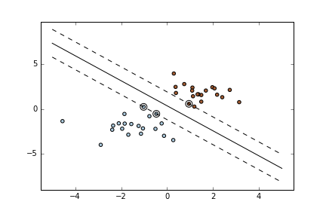
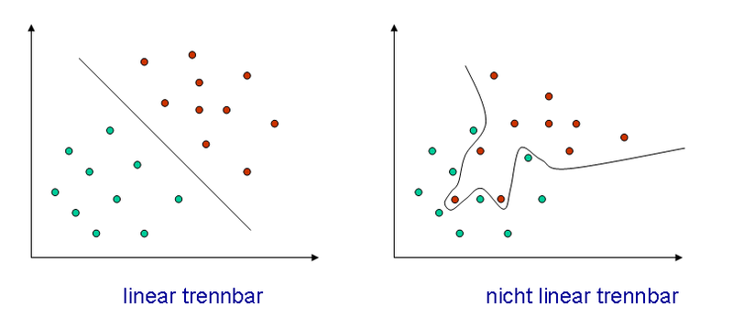
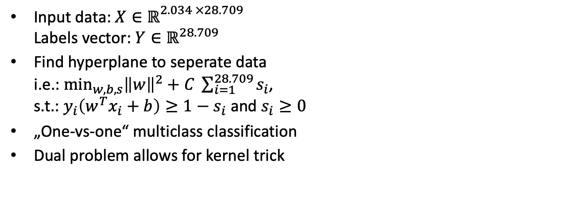
SVM – General Idea
Input data: $X∈ℝ^{\begin{aligned}2.034 ×28.709 \\ \end{aligned}}$ Labels vector: $Y∈ℝ^{28.709}$
Find hyperplane to seperate data i.e.: $\min_{w, b, s}{{\left\|w\right\|}^{2}+C \sum_{i=1}^{28.709}{s_{i}}}$, s.t.: $y_{i}\left(w^{T}x_{i}+b\right)≥1−s_{i}$ and $s_{i}≥0$
„One-vs-one“ multiclass classification
Dual problem allows for kernel trick

Slide 17
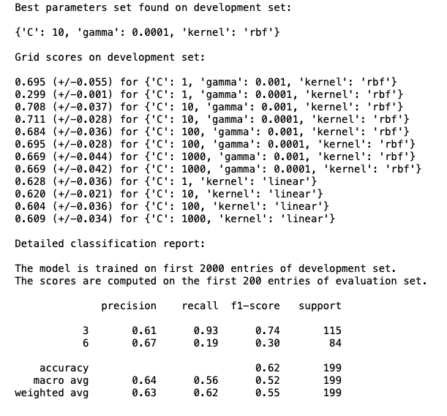

SVM – Parameter Choice
import Scikit-learn
Grid search
Cross-validation
Best parameter choice: Kernel = $exp⁡(−γ{\left\|x−y\right\|}^{2})$ $C$ = 10, $γ$ = 0.0001

Slide 18
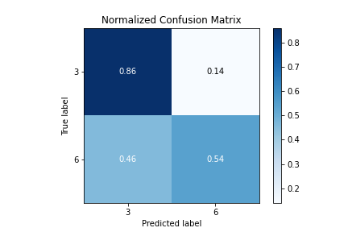
SVM
Accuracy of 42.7% for all 7 classes
Accuracy of 56.7% for happy / sad /neutral
Accuracy of 73% for happy / neutral
happy
neutral

Slide 19
CNN
convolutional
SoftPlus
Leaky ReLU
What type of layers to use?
Which activation function?
fully connected
layer size
Rectified linear unit (ReLU)
batch normalization
max pooling
Exponential linear unit (ELU)
dropout
How to prevent overfitting?
early stopping
image generator
01.07.2020
Group 5 - Facial emotion recognition

Slide 20
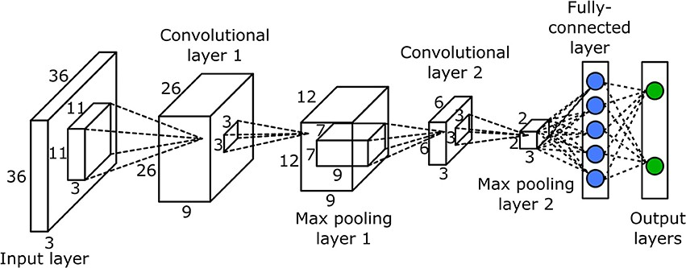
CNN architecture
Fully connected layer:
Classifies the output of the convolution and pooling process
Max pooling layer:
Reduces the complexity of a network by combining several nodes to the maximum value
Convolutional layer:
Uses convolution to find certain features in an image
01.07.2020
Group 5 - Facial emotion recognition

Slide 21
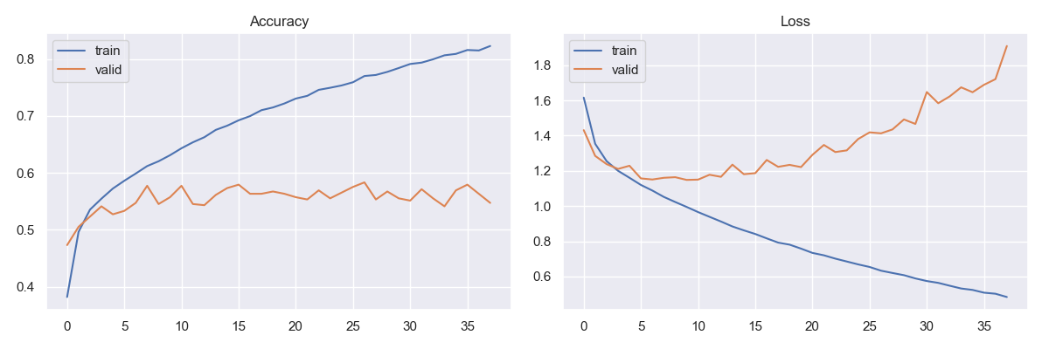
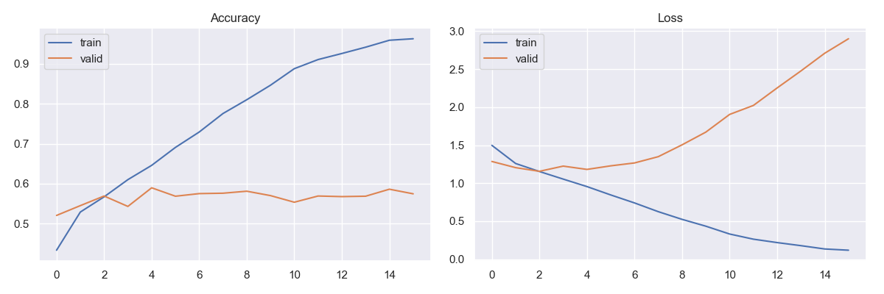
CNN
Overfitting
Training process with ELU is a lot faster
90% trainings accuracy after 10 epochs vs 80% after 30 epochs
Problem of rising validation loss function: Overfitting
ReLU
Activation function
ELU
Overfitting
01.07.2020
Group 5 - Facial emotion recognition

Slide 22
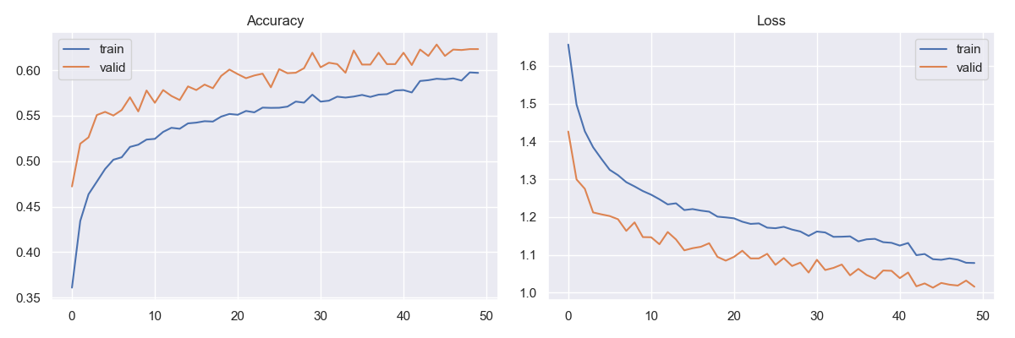
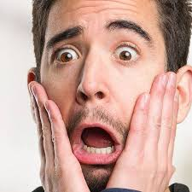
CNN
Overfitting Problem:
Image Generator
Instead of using static training data, it uses images from the trainings data that are randomly shifted, rotated, mirrored, scaled and sheared.
Early stopping and restoring weights after recognising stagnant validation accuracy / validation loss
Accuracy with Image Generator
01.07.2020
Group 5 - Facial emotion recognition

Slide 23
CNN
Overfitting Problem:
Image Generator
Instead of using static training data, it uses images from the trainings data that are randomly shifted, rotated, mirrored, scaled and sheared.
Early stopping and restoring weights after recognising stagnant validation accuracy / validation loss
Loss with Image Generator
01.07.2020
Group 5 - Facial emotion recognition

Slide 24
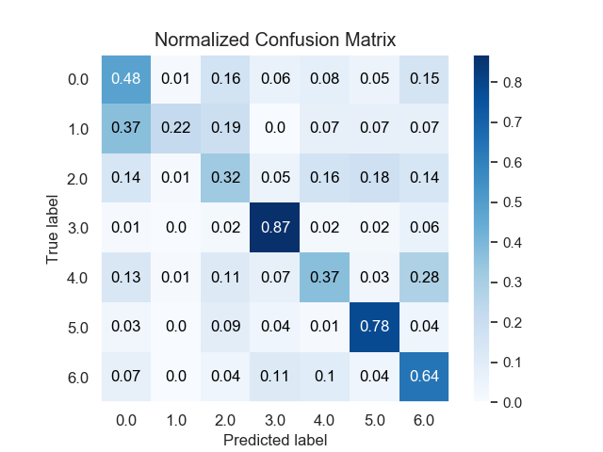
CNN
angry
disgust
62% accuracy with 7 emotions
good with happy and surprise
trouble with disgust, fear and sad
disgust is almost never predicted
least represented in data set
fear
happy
sad
surprise
neutral
01.07.2020
Group 5 - Facial emotion recognition

Slide 25
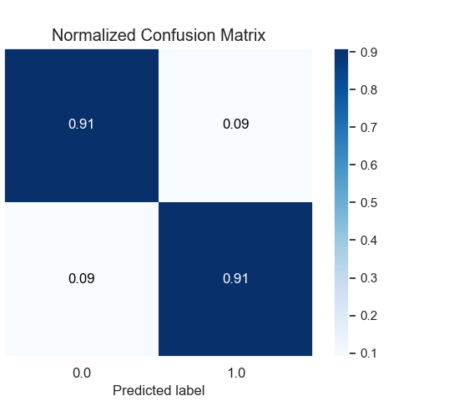
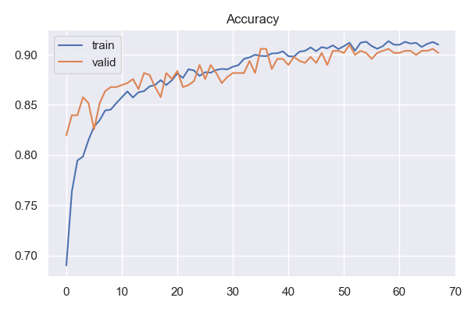
CNN
CNN trained for 2 emotions
restore weights
neutral
labeled as neutral
happy
91% accuracy with 2 emotions
many misclassifications are debatable
labeled as happy
01.07.2020
Group 5 - Facial emotion recognition

Slide 26
Comparison
 | Adaboost | SVM | CNN
7 Emotions | 36,4 % | 42,7 % | 62 %
Happy / Sad / Neutral | 56,7 % | 56,7 % | 78 %
Happy / Neutral | 73,3 % | 73 % | 91 %

Slide 27
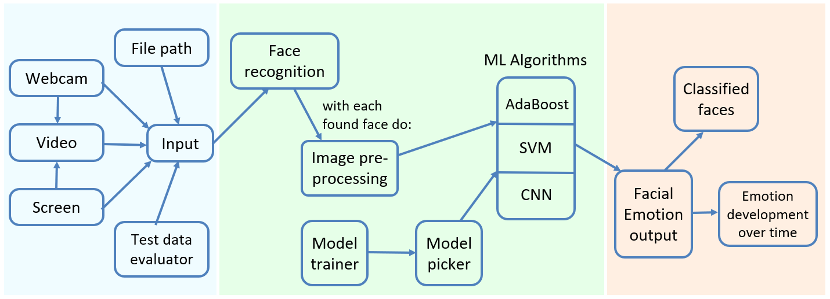
Product Presentation

Slide 28
Conclusion
Goals | Final status
Learn to work together | We established a frequent comunication and discussed the upcoming problems/ideas at least weekly
Research different ML methods | We collected different algorithms to tackle our given problem. We explained the idea behind our algorithms to the others in our meetings and wrote a brief overview for each algorithm in LaTeX.
Implement at least one ML algorithm in Python and optimize its accuracy | We implemented four algorithms which try to solve the initial problem. Even though we knew from the beginning that CNN seems to be the best choice we build other solutions to confirm our initial thoughts.
Notes:
At the beginning we were a little bit lost/unstructured because we didnt knew how to organize ourselfs and define timeslots, but managed to implement 4 different algortihms for the same problem.

Slide 29
Responsibilities
Name | Tasks / Roles
Max | Project Manager, Git introduction, SVM implementation, SVM documentation, dataset
Giulia | Documentation of goals and progress, general machine learning documentation, dataset
Jonas | NN implementation, NN documentation, GUI, dataset
Timo | Decision Trees, adaboost implementation, dataset, presentation
John | KNN implementation, dataset
Notes:
At the beginning we were a little bit lost/unstructured because we didnt knew how to organize ourselfs and define timeslots, but managed to implement 4 different algortihms for the same problem.

Slide 30
Thank you!
Notes:
At the beginning we were a little bit lost/unstructured because we didnt knew how to organize ourselfs and define timeslots, but managed to implement 4 different algortihms for the same problem.

Slide 31
Quellen Bilder:
All pictures are free for non-commercial use.
Deckblatt: https://commons.wikimedia.org/wiki/File:Emotion_Recognition_Deficit.jpg
Agenda:
https://commons.wikimedia.org/wiki/File:Hey_Machine_Learning_Logo.png
Intro:
https://commons.wikimedia.org/wiki/File:5th_Floor_Lecture_Hall.jpg
https://www.pikist.com/free-photo-sobwr
Project:
Product:
SVM:
https://de.wikipedia.org/wiki/Datei:Diskriminanzfunktion.png
Notes:
Ausgeblendete Backupslide

Slide 32
Quellen Code:
All pictures are free for non-commercial use.
TBA
Notes:
Ausgeblendete Backupslide

